Slide 1
Accident Detection
Rohan Inamdar
S. Kavin Sundarr
Shaik Nadeem

Slide 2
High-Level Design
Briefly introduce YOLO (You Only Look Once) concept.
Highlight YOLO's real-time processing capabilities.
YOLOv8 utilizes a feature-rich backbone architecture for effective object detection.
Built on Darknet, an open-source neural network framework.
Adaptive anchor boxes for diverse object scales and shapes.
Multiple Resolutions:
Feature pyramids at various resolutions for comprehensive detection.
Training Strategy:
Fine-tuned on custom datasets for precision and recall.

Slide 3
Program Logic
The provided code snippet demonstrates the program logic for training and deploying a YOLOv8-based crash detection model. Here's a breakdown:
Environment Setup:
GPU information is checked using !nvidia-smi. Necessary libraries like Ultralytics and Roboflow are installed.
Data Preparation:
Roboflow is used to download a dataset named "yolov8" associated with the project "car-accident-xl372.“
Model Training:
The YOLOv8 model is trained using the specified parameters, including the YOLOv8 variant (yolov8n.pt), training data configuration file (data.yaml), number of epochs (50), image size (800), and the option to generate plots during training.
Results Analysis:
Validation is performed using a trained model (best.pt), and the results are analyzed using the validation data and configuration.
Deployment:
The trained YOLOv8 model is deployed to the specified Roboflow project version for further use

Slide 4
Tech Stack Used
Roboflow for Data Labeling:
Roboflow is a platform designed to streamline and simplify the data labeling process, a crucial step in training machine learning models, especially for computer vision tasks like object detection. Here's an explanation of how Roboflow facilitates data labeling
WordPress for Website Development:
WordPress is a popular content management system (CMS) that is widely used for website development. Here's an explanation of how WordPress is leveraged for building websites, including the end-to-end website mentioned in your context:
YOLOv8 for Model Training:
YOLOv8, short for You Only Look Once version 8, is an advanced real-time object detection model. It belongs to the family of YOLO models, known for their ability to perform object detection with impressive speed and accuracy. YOLOv8 builds upon its predecessors, incorporating enhancements to improve detection performance and versatility.

Slide 5
Limitations and Future Scope
Observations:
Lower accuracy observed in the model's detection results for bike and bike accidents compared to car and car accidents.
Limitation Recognition:
Acknowledgment of the current limitation in the model's performance in bike-related scenarios.
Recommendation for Improvement:
Key recommendation: Augment the dataset with an extensive collection of bike accident-related data.
Purpose of Data Augmentation:
Enriching the dataset with diverse and representative examples of bike accidents.
Learning and Generalization:
Providing the model with a better opportunity to learn and generalize patterns specific to bike-related incidents.
Achieving Parity:
The goal is to ensure that the model achieves parity in performance across different classes, specifically enhancing accuracy in both car and bike accident detections.
FUTURE SCOPE:
Designing an intelligent CCTV monitoring network integrated with our advanced accident detection model is a transformative step towards enhancing public safety. In this innovative system, our model will analyze live CCTV feeds for real-time accident detection. Upon detecting an accident, an automatic SOS SMS will be promptly dispatched to the nearest ambulance service, ensuring swift response and rescue operations.

Slide 6
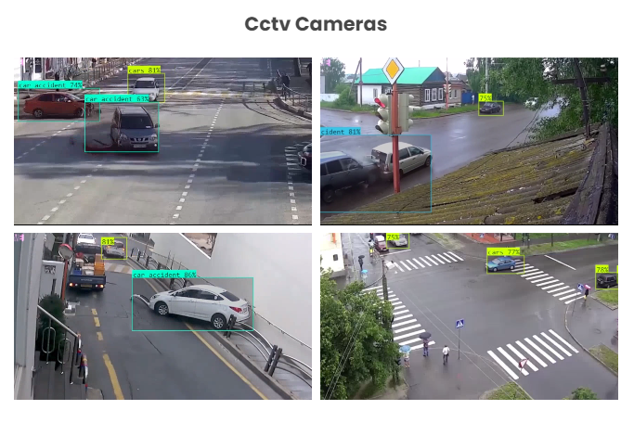
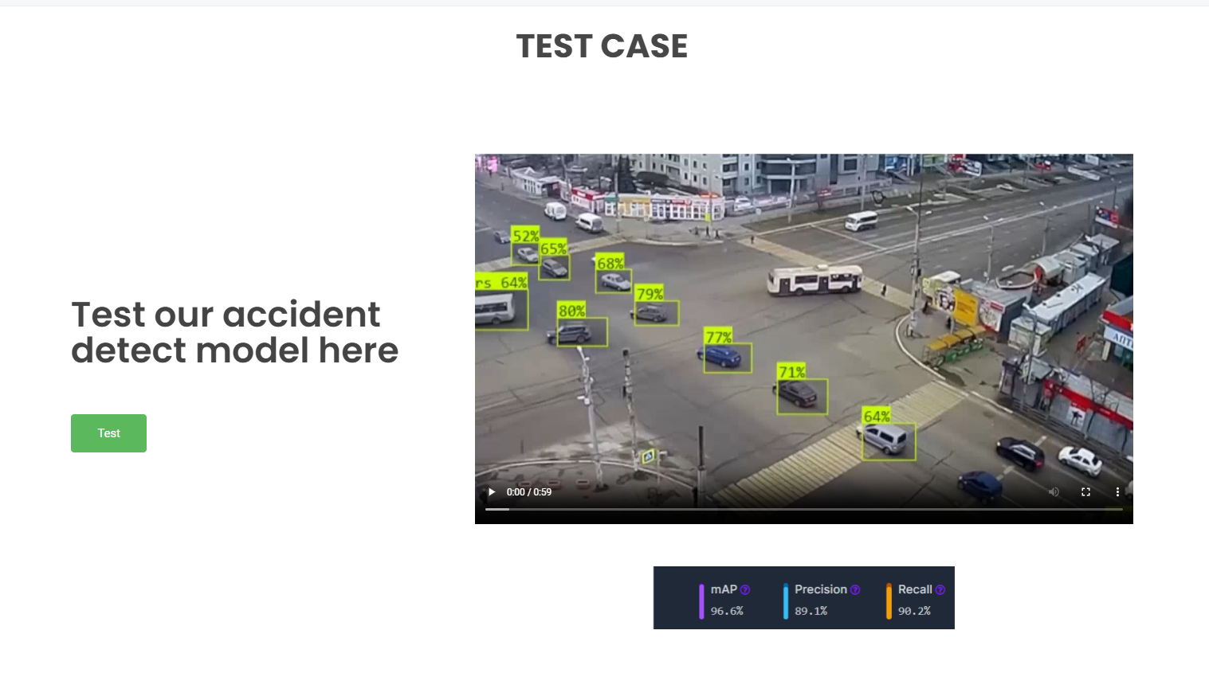
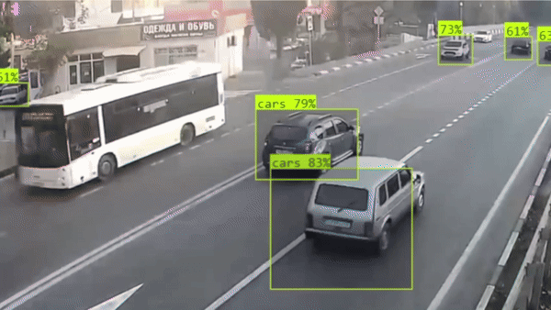
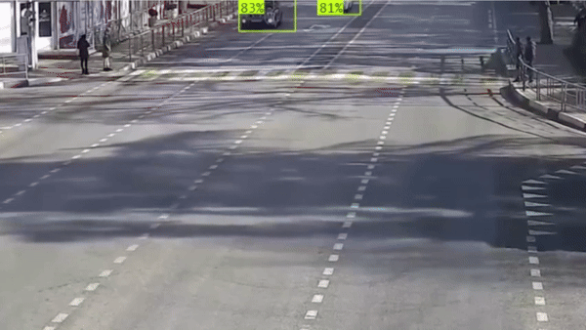
Screenshot of Outputs

Slide 7
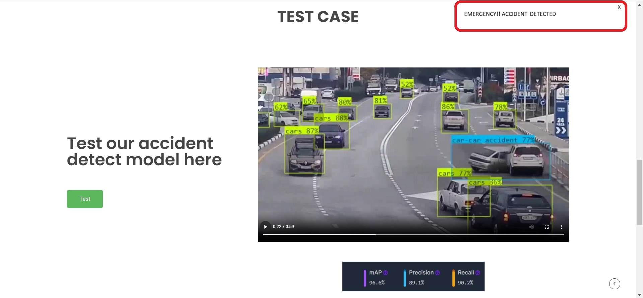
CONT…

Slide 8
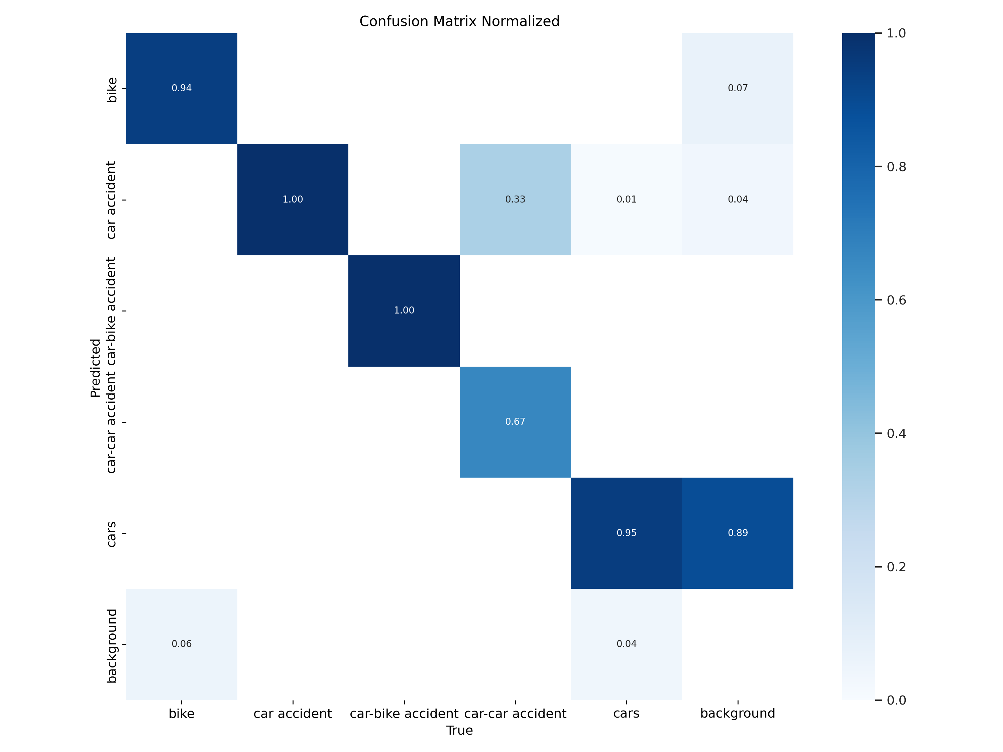
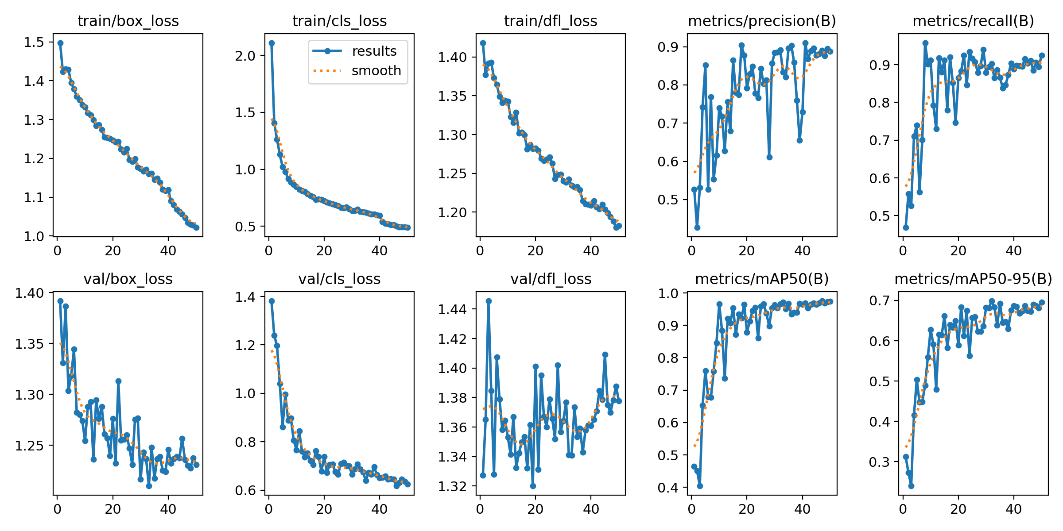
RESULTS
Mean Average Precision (mAP) of 96.6, along with precision and recall scores of 89.1 and 90.2, respectively.

Slide 9
THANK YOU
Mirjam Nilsson​
mirjam@contoso.com
www.contoso.com

